Slide 1
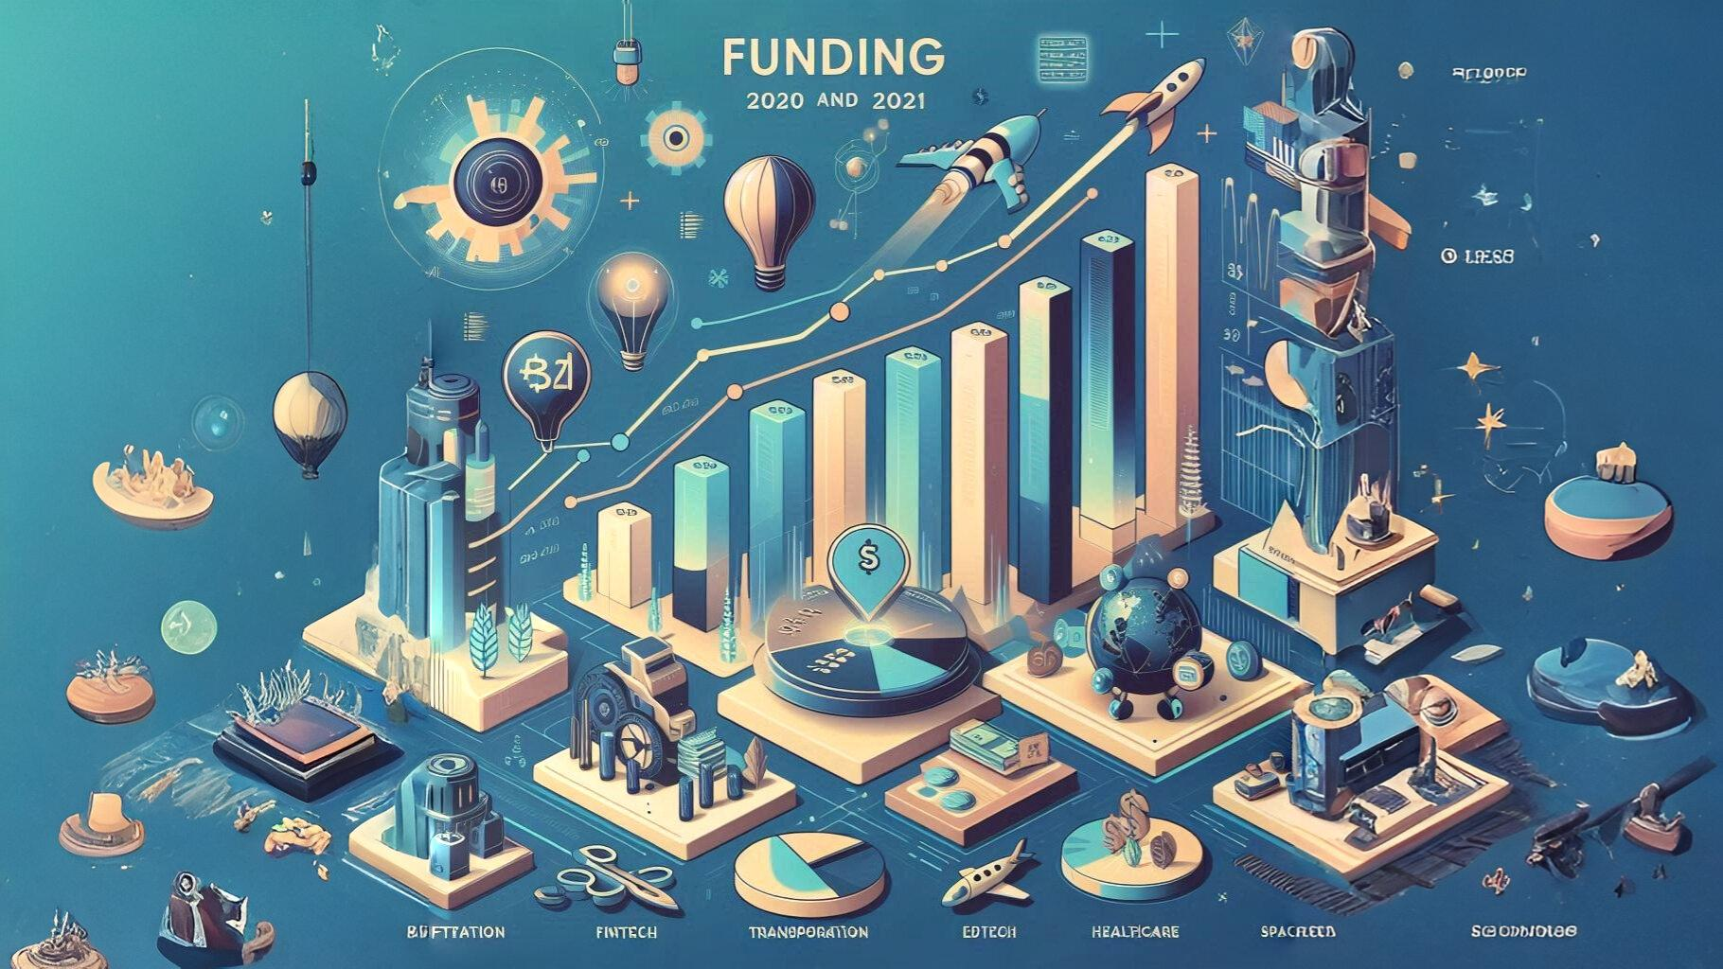

Slide 2
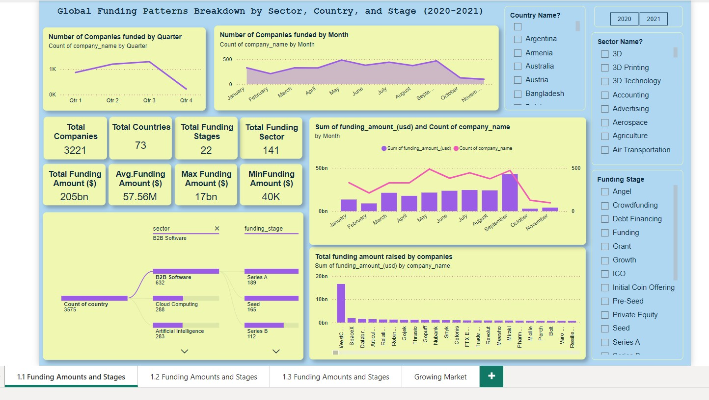

Slide 3
Insight
3221 companies were funded across 73 countries in 141 sectors, showcasing broad global participation.
Total funding amount reached $205 billion, with an average funding amount of $57.56 million per company.
In 2020 Funding peaked in Q2 & Q3 and gradually declined toward Q4.
In 2021 Funding peaked in Q2 only and gradually declined toward Q3.
Q4 experienced the lowest funding activity, indicating seasonal slowdowns.
B2B Software, Cloud Computing, and Artificial Intelligence were top-funded sectors.
Overall, Funding amounts spiked in May and August, with a sharp decline in October–December.

Slide 4
Actionable Strategy
Focus marketing and outreach efforts in Q2 to capitalize on peak funding periods.
Funding amounts and company counts are highest in Q2. Plan product launches and funding rounds around these months to maximize visibility and funding opportunities.
Focus marketing and outreach efforts in Q2 to capitalize on peak funding periods.

Slide 5
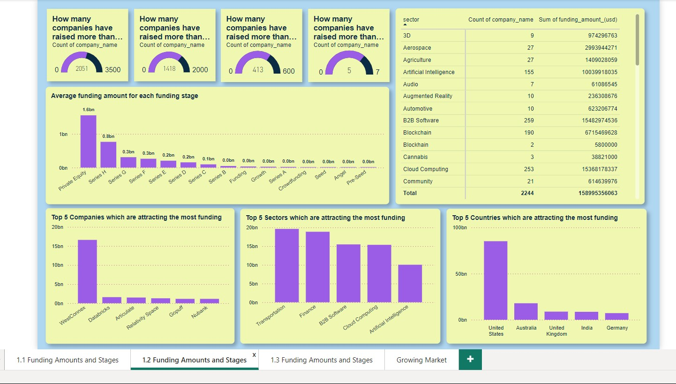

Slide 6
Insight
3068 companies have raised more than $1 million.
1975 companies have raised more than $10 million.
504 companies have raised more than $100 million.
Only 7 companies have raised more than $1 billion.
Private equity has the highest average funding amount at $1.6 billion in 2021.
WesComex has attracted the most funding at approximately $16.6 billion.
B2B Software, Transportation and Finance sectors are attracting the most funding, total around $45 billion.
The United States is attracting the most funding, around $117 billion.
In transportation WesComex and Goqii received 85% funding out of $19.6 billion. Both are from raise funding from Australia.
Niche sectors like Aerospace (32 companies, $5.71B) and Agriculture (30 companies, $1.44B) show growth potential.

Slide 7
Actionable Strategy
Analyze WesComex's funding strategies and success factors to create a best practices guide for other companies.

Slide 8
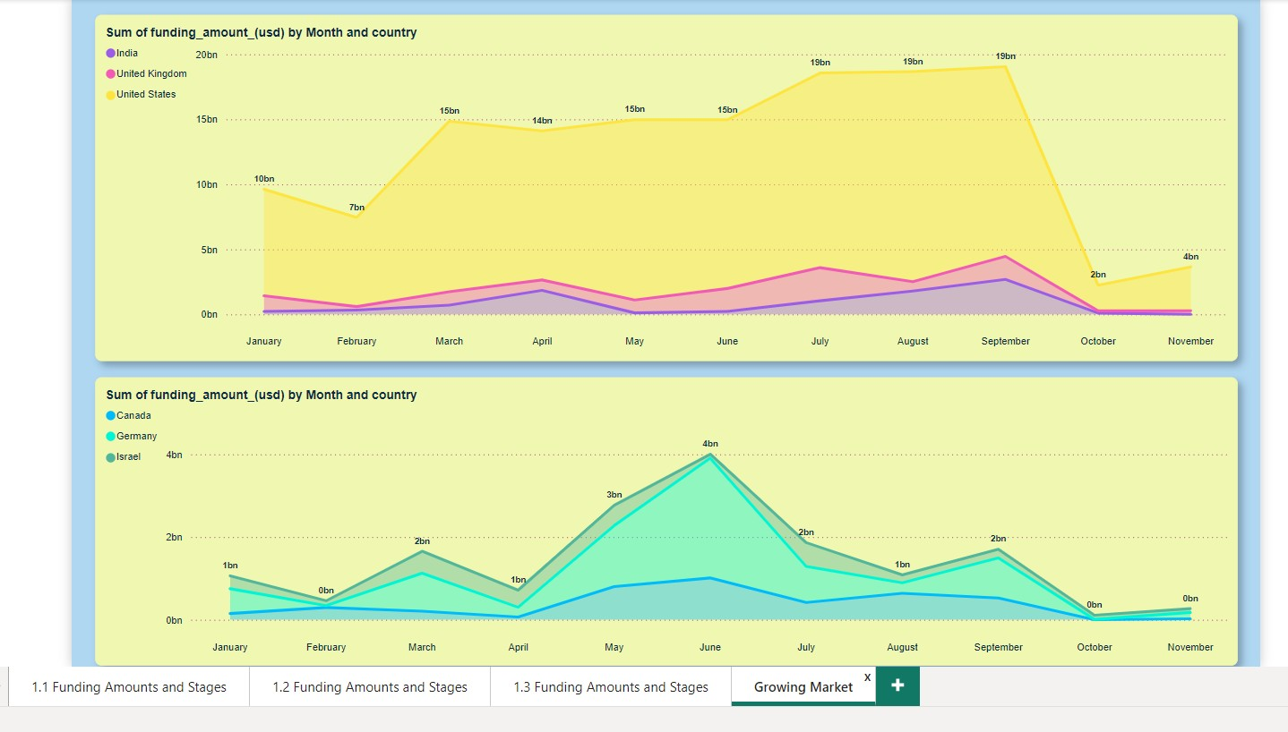

Slide 9
Insight
The United States consistently dominates tech funding, peaking at $19 billion in multiple months.
India shows stable growth, contributing significant funding amounts across the year, particularly in Q3.

